Slide 1

Diamonds Predictor Application
Machine Learning for Pricing, Quality Assessment, and Customer Segmentation
Presented by Saad Ehsan
Notes:
Hello everyone. My name is Saad, and today I’m presenting my Diamonds Predictor Application. This project uses machine learning to predict diamond prices, classify diamond clarity, segment customers, and provide an AI assistant for diamond analysis. It’s a complete end‑to‑end data science project.”

Slide 2
What This Project Is About
Diamonds Predictor Application
Diamonds Predictor Application — End‑to‑End ML System
This project is an end‑to‑end machine learning system designed to help a diamond retailer:
Price Prediction — Estimate diamond prices using an ANN regression model
Clarity Prediction — Classify diamond clarity using an ANN classifier
Customer Segmentation — Group diamonds into meaningful market clusters
AI Assistant — Natural‑language search for diamond insights
Interactive Web App — Gradio interface for easy use and deployment
Notes:
Before I begin, let me quickly explain what this project actually is. I built a complete end‑to‑end machine learning system for the diamond industry. It can predict diamond prices, classify diamond clarity, segment diamonds into meaningful market groups, and even answer natural‑language questions through an AI assistant. All of this is deployed inside a Gradio web application, making the system interactive and easy for anyone to use. So in the next few slides, I’ll show you how each part works.

Slide 3

Business Problem
How can a diamond retailer accurately price diamonds, assess their quality, and segment customers to improve sales and profitability?
Notes:
The diamond industry faces three major challenges: First, pricing diamonds accurately is difficult because many features influence price. Second, clarity grading requires expert knowledge and is time‑consuming. Third, customers vary widely in budget and preferences, so segmentation is important. My project solves all three problems using machine learning.”

Slide 4
Dataset
OVERVIEW
# | carat | cut | color | clarity | depth | table | price | x | y | z
1 | 0.23 | Ideal | E | SI2 | 61.5 | 55 | 326 | 3.95 | 3.98 | 2.43
2 | 0.21 | Premium | E | SI1 | 59.8 | 61 | 326 | 3.89 | 3.84 | 2.31
3 | 0.23 | Good | E | VS1 | 56.9 | 65 | 327 | 4.05 | 4.07 | 2.31
4 | 0.29 | Premium | I | VS2 | 62.4 | 58 | 334 | 4.2 | 4.23 | 2.63
5 | 0.31 | Good | J | SI2 | 63.3 | 58 | 335 | 4.34 | 4.35 | 2.75
6 | 0.24 | Very Good | J | VVS2 | 62.8 | 57 | 336 | 3.94 | 3.96 | 2.48
7 | 0.24 | Very Good | I | VVS1 | 62.3 | 57 | 336 | 3.95 | 3.98 | 2.47
8 | 0.26 | Very Good | H | SI1 | 61.9 | 55 | 337 | 4.07 | 4.11 | 2.53
9 | 0.22 | Fair | E | VS2 | 65.1 | 61 | 337 | 3.87 | 3.78 | 2.49
10 | 0.23 | Very Good | H | VS1 | 59.4 | 61 | 338 | 4.0 | 4.05 | 2.39
Diamonds Predictor Application
Source: Kaggle
Rows: 53,940
Features: carat, depth, table, x, y, z, price, cut, color, clarity
Notes:
I used the Diamonds dataset from Kaggle, which contains over fifty‑three thousand rows. It includes numeric features like carat and price, and categorical features like cut, color, and clarity. This dataset is widely used in ML research and represents real diamond market data.

Slide 5
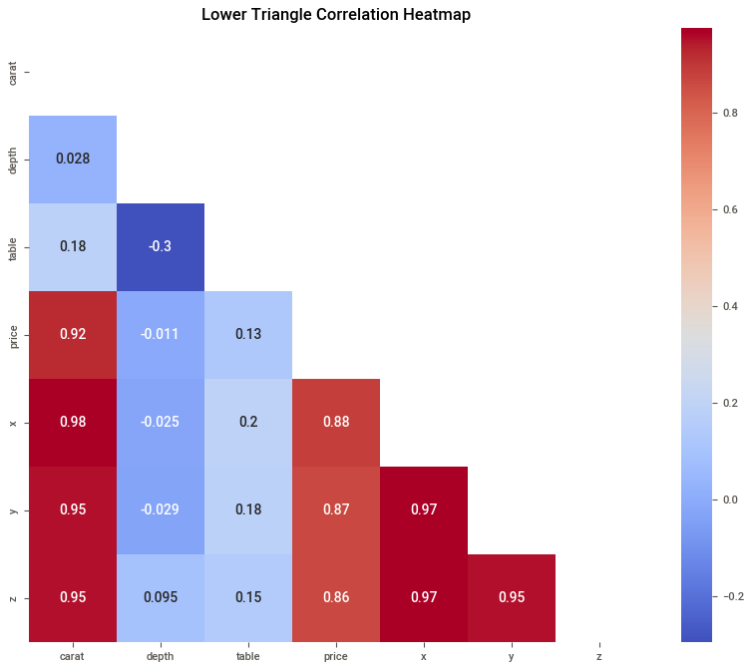
key eda insights
Diamonds Predictor Application
Strong correlation between carat and price
No missing values
Outliers removed
Clear patterns between cut, color, clarity and price
Sweetviz automated report generated
High correlation means the model can learn strong predictive patterns
Notes:
EDA showed a very strong correlation between carat and price, no missing values, and clear patterns between quality features and price. The heatmap highlights how carat, x, y, and z all strongly relate to price. Outliers were removed, and a Sweetviz report confirmed these insights.

Slide 6

Preprocessing Pipeline
Diamonds Predictor Application
Removed duplicates
Removed invalid rows
One‑Hot Encoding – Text categories need numeric encoding
Standard Scaling – To prevent large values dominating training.
Train/Test split
Notes:
To prepare the data, I removed duplicates and physically impossible rows. I encoded categorical features using One‑Hot Encoding and scaled numeric features using StandardScaler. Finally, I split the dataset into training and testing sets. This ensures the models learn from clean, consistent data.

Slide 7
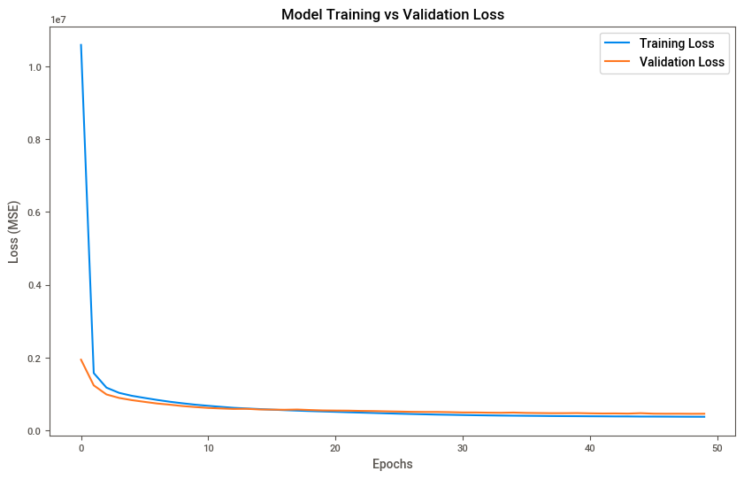
ANN Regression Model (Price Prediction)
Diamonds Predictor Application
Architecture:
Dense(64, relu)
Dense(32, relu)
Dense(1, linear)
Metrics:
MAE = Mean Absolute Error
MSE = Mean Squared Error
RMSE = Root Mean Squared Error
R² = Coefficient of Determination (R-Squared)
Notes:
For price prediction, I built an Artificial Neural Network with two hidden layers. The model was evaluated using MAE, MSE, RMSE, and R². The results showed strong predictive accuracy, meaning the model can estimate diamond prices effectively.

Slide 8
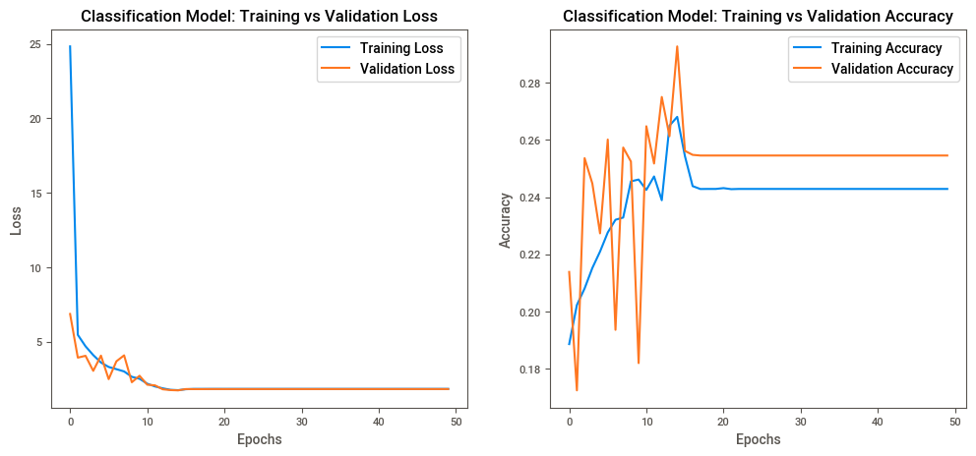
ANN classification Model (clarity Prediction)
Diamonds Predictor Application
Architecture:
Dense(64, relu)
Dense(32, relu)
Dense(8, softmax)
Metrics:
Accuracy
Precision
Recall
F1‑Score
Notes:
For clarity prediction, I built another ANN classifier. It predicts clarity categories such as SI1, VS2, and IF. The model achieved good accuracy and strong precision and recall across most classes. This shows the model learned clarity patterns well.

Slide 9
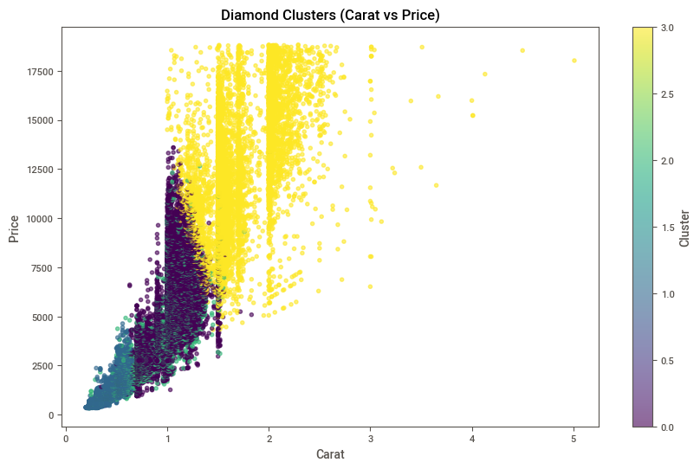
Customer Segmentation (Clustering)
Diamonds Predictor Application
Method: KMeans
KMeans is fast, simple, and works well with scaled numeric data
Evaluation: Silhouette Score
Silhouette Score measures how well clusters are separated.
Higher score = better clustering
Clusters:
High‑carat, high‑price
Mid‑range
Small, low‑price
Unusual proportions
Notes:
I applied KMeans clustering to segment diamonds into meaningful groups. Using scaled numeric features and price, the model produced four clear clusters. These clusters represent luxury diamonds, mid‑tier diamonds, budget diamonds, and diamonds with unusual proportions. The silhouette score confirmed good separation between clusters.

Slide 10

Ai assistant
Diamonds Predictor Application
Natural language search
Explains results
Finds diamonds based on user intent
Notes:
I also built an AI assistant that allows users to search the dataset using natural language. For example, users can ask for ‘expensive diamonds’ or ‘large premium diamonds.’ The assistant filters the dataset and explains the results like a human expert. This adds intelligence and usability to the system.

Slide 11
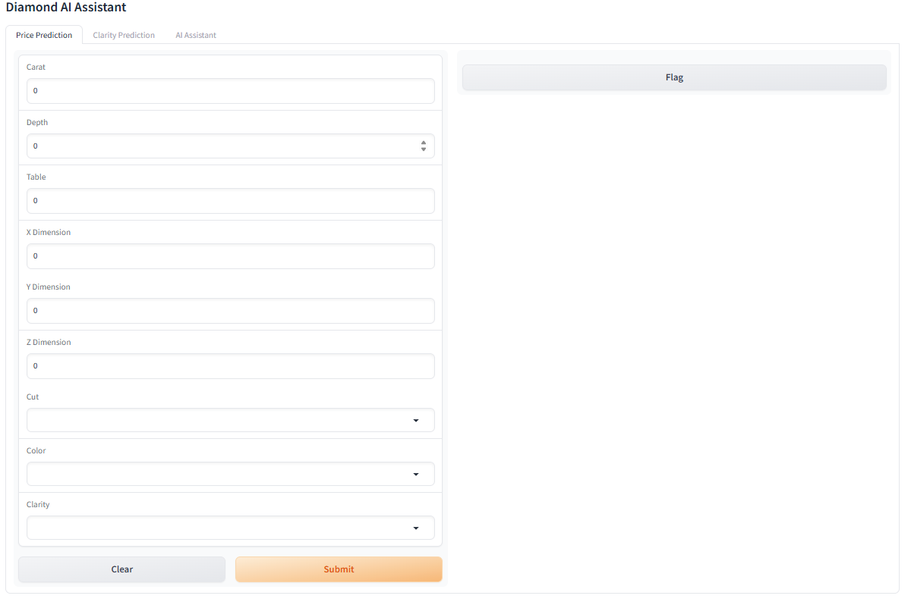
Gradio Web Application
Diamonds Predictor Application
Tabs:
Price Prediction
Clarity Prediction
AI Assistant
Notes:
This is the Gradio app that brings all the models together. Users can predict price, predict clarity, or ask the AI assistant questions. Gradio makes the entire system interactive and easy to use.

Slide 12
Model Comparison Summary
Diamonds Predictor Application
The regression model predicts price accurately.
The classification model predicts clarity reliably.
The clustering model segments diamonds into meaningful groups.
Together, these models solve the business problem I introduced at the beginning.
Notes:
Here’s the big picture: Price prediction, clarity prediction, and customer segmentation — three models working together to solve real business challenges in the diamond industry. This is what makes the Diamonds Predictor Application a complete, practical, and powerful machine learning system.

Slide 13
Conclusion & Future Work
Diamonds Predictor Application
Conclusion:
Complete ML pipeline
Accurate price prediction
Automated clarity grading
Customer segmentation
Deployed Gradio app
AI assistant
Future Work:
Add XGBoost or CNN models
Deploy on HuggingFace Spaces
Add recommendation system
Add real‑time pricing API
Notes:
This project demonstrates a full end‑to‑end machine learning solution for the diamond industry. It predicts prices, grades clarity, segments customers, and provides an AI assistant. In the future, I can improve the models using XGBoost or CNNs, deploy the app on HuggingFace Spaces, and add a recommendation system or real‑time pricing API. Thank you.

Slide 14

Q & A
Let’s discuss questions
as a team.
Notes:
That concludes my presentation. I’m happy to answer any questions you have — whether technical or business‑related. Let’s discuss them together.

